Slide 1
Austin Animal Center Shelter
Data Analysis - Project 1

Slide 2
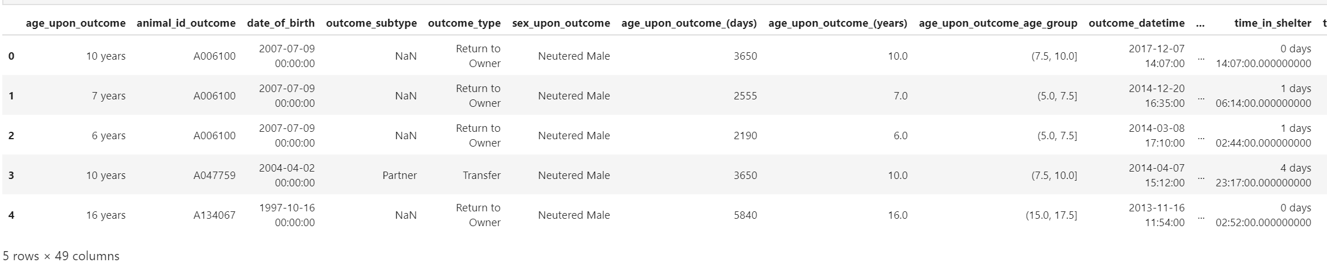
Data Source
Austin Animal Center Shelter
https://www.kaggle.com/aaronschlegel/austin-animal-center-shelter-intakes-and-outcomes

Slide 3
Data Source
Austin Animal Center Shelter
What factors are most important in determining outcome type?
Do cats get adopted more frequently than dogs?
Do certain breeds get adopted more often than others? Does coat color affect adoption rates within breeds?
How does wildlife fare with respect to domestic animals? How about non-cat/dog animals? Compare wildlife to domestic animal types
How does intake condition impact outcome? Do sick animals fare worse when it comes to adoption?
How does age of animal affect outcome?
How does sex of animal affect outcome?
How does length of stay in shelter affect outcome?
In general, what animals live the longest?

Slide 4
Data Source
Austin Animal Center Shelter
What leads people to drop animals off?
Do economic factors (e.g. average income by zip code) correlate with locations in intake data? (requires blending)
Are there population density factors impacting intake rates? I.e. do animals get picked up more often in rural locations or dense urban locations? (requires blending)
Do extreme weather events correlate with spikes in intake? (requires blending)
Are there seasonal, monthly, or weekly patterns in intake volume?
Can we infer why random wildlife is showing up at animal shelters?
Are there trends in non-cat/dog animals showing up at shelters?
BASIC QUESTION:
What factors impact whether animals get spayed/neutered?
Do cats get spayed/neutered more frequently than dogs?
Do older animals get spayed/neutered less frequently than younger animals?
How do outcome types affect neutering/spaying rates?
Which type/breed of animal is more commonly brought in already spayed/neutered?

Slide 5
Clean up data and APIs
Address
Colony Creek And Hunters Trace in Austin (TX)
8700 Research Blvd in Austin (TX)
12034 Research Blvd in Austin (TX)
Austin (TX)
Ih 35 And 41St St in Austin (TX)
Gatlin Gun Rd And Brodie in Austin (TX)
Austin (TX)
Final Address
Street
Zip Code
Latitude
Longitude
API
Google API
Zip codes
Latitude
Longitude
Census.gov
Income
Population

Slide 6
Austin Animal Center Shelter
Data Analysis - Project 1

Slide 7
Data Source
Austin Animal Center Shelter
https://www.kaggle.com/aaronschlegel/austin-animal-center-shelter-intakes-and-outcomes

Slide 8
Data Source
Austin Animal Center Shelter
What factors are most important in determining outcome type?
Do cats get adopted more frequently than dogs?
Do certain breeds get adopted more often than others? Does coat color affect adoption rates within breeds?
How does wildlife fare with respect to domestic animals? How about non-cat/dog animals? Compare wildlife to domestic animal types
How does intake condition impact outcome? Do sick animals fare worse when it comes to adoption?
How does age of animal affect outcome?
How does sex of animal affect outcome?
How does length of stay in shelter affect outcome?
In general, what animals live the longest?

Slide 9
Data Source
Austin Animal Center Shelter
What leads people to drop animals off?
Do economic factors (e.g. average income by zip code) correlate with locations in intake data? (requires blending)
Are there population density factors impacting intake rates? I.e. do animals get picked up more often in rural locations or dense urban locations? (requires blending)
Do extreme weather events correlate with spikes in intake? (requires blending)
Are there seasonal, monthly, or weekly patterns in intake volume?
Can we infer why random wildlife is showing up at animal shelters?
Are there trends in non-cat/dog animals showing up at shelters?
BASIC QUESTION:
What factors impact whether animals get spayed/neutered?
Do cats get spayed/neutered more frequently than dogs?
Do older animals get spayed/neutered less frequently than younger animals?
How do outcome types affect neutering/spaying rates?
Which type/breed of animal is more commonly brought in already spayed/neutered?

Slide 10
Clean up data and APIs
Address
Colony Creek And Hunters Trace in Austin (TX)
8700 Research Blvd in Austin (TX)
12034 Research Blvd in Austin (TX)
Austin (TX)
Ih 35 And 41St St in Austin (TX)
Gatlin Gun Rd And Brodie in Austin (TX)
Austin (TX)
Final Address
Street
Zip Code
Latitude
Longitude
API
Google API
Zip codes
Latitude
Longitude
Census.gov
Income
Population

Slide 11
Austin Animal Center Shelter
Data Analysis - Project 1

Slide 12
Data Source
Austin Animal Center Shelter
https://www.kaggle.com/aaronschlegel/austin-animal-center-shelter-intakes-and-outcomes

Slide 13
Data Source
Austin Animal Center Shelter
What factors are most important in determining outcome type?
Do cats get adopted more frequently than dogs?
Do certain breeds get adopted more often than others? Does coat color affect adoption rates within breeds?
How does wildlife fare with respect to domestic animals? How about non-cat/dog animals? Compare wildlife to domestic animal types
How does intake condition impact outcome? Do sick animals fare worse when it comes to adoption?
How does age of animal affect outcome?
How does sex of animal affect outcome?
How does length of stay in shelter affect outcome?
In general, what animals live the longest?

Slide 14
Data Source
Austin Animal Center Shelter
What leads people to drop animals off?
Do economic factors (e.g. average income by zip code) correlate with locations in intake data? (requires blending)
Are there population density factors impacting intake rates? I.e. do animals get picked up more often in rural locations or dense urban locations? (requires blending)
Do extreme weather events correlate with spikes in intake? (requires blending)
Are there seasonal, monthly, or weekly patterns in intake volume?
Can we infer why random wildlife is showing up at animal shelters?
Are there trends in non-cat/dog animals showing up at shelters?
BASIC QUESTION:
What factors impact whether animals get spayed/neutered?
Do cats get spayed/neutered more frequently than dogs?
Do older animals get spayed/neutered less frequently than younger animals?
How do outcome types affect neutering/spaying rates?
Which type/breed of animal is more commonly brought in already spayed/neutered?

Slide 15
Clean up data and APIs
Address
Colony Creek And Hunters Trace in Austin (TX)
8700 Research Blvd in Austin (TX)
12034 Research Blvd in Austin (TX)
Austin (TX)
Ih 35 And 41St St in Austin (TX)
Gatlin Gun Rd And Brodie in Austin (TX)
Austin (TX)
Final Address
Street
Zip Code
Latitude
Longitude
API
Google API
Zip codes
Latitude
Longitude
Census.gov
Income
Population

Slide 16


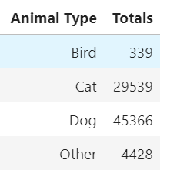
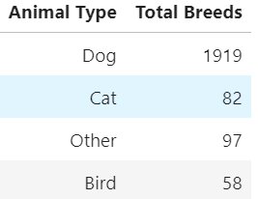
Data Source
Austin Animal Center Shelter
Total Records: 79,672

Slide 17
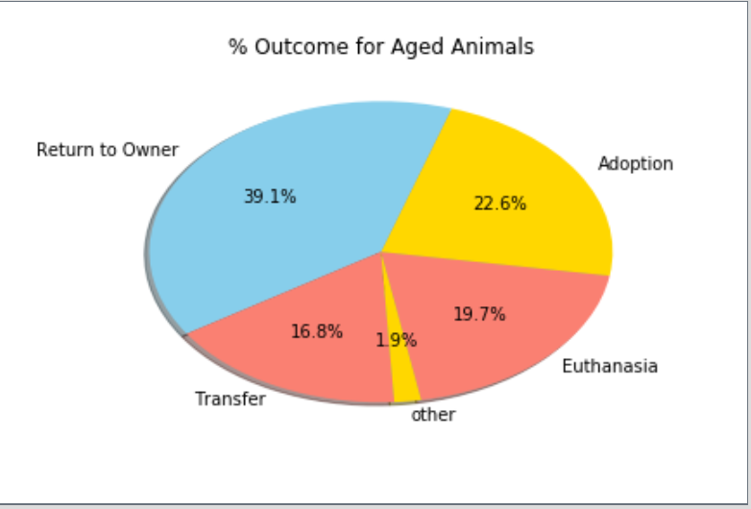
Data Source
Austin Animal Center Shelter

Slide 18
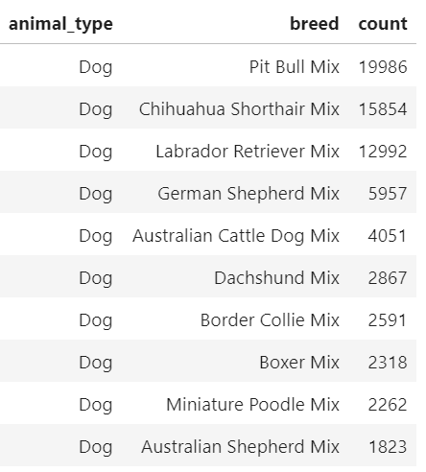
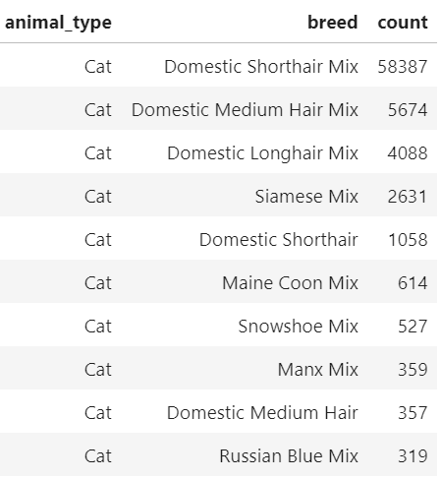
Data Source
Austin Animal Center Shelter

Slide 19
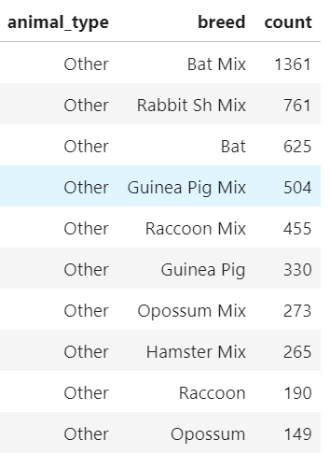
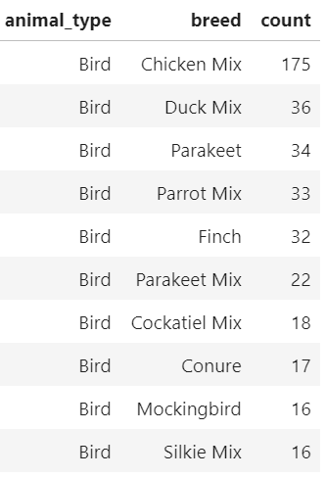
Data Source
Austin Animal Center Shelter

Slide 20
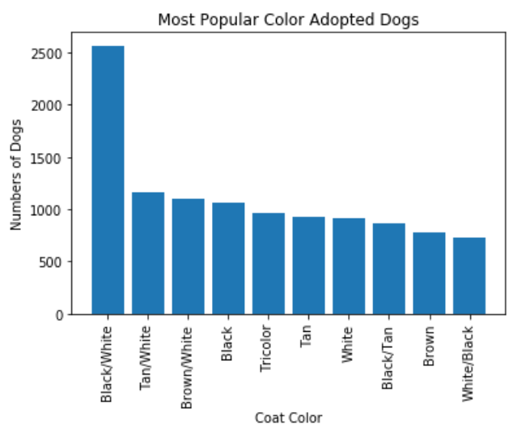
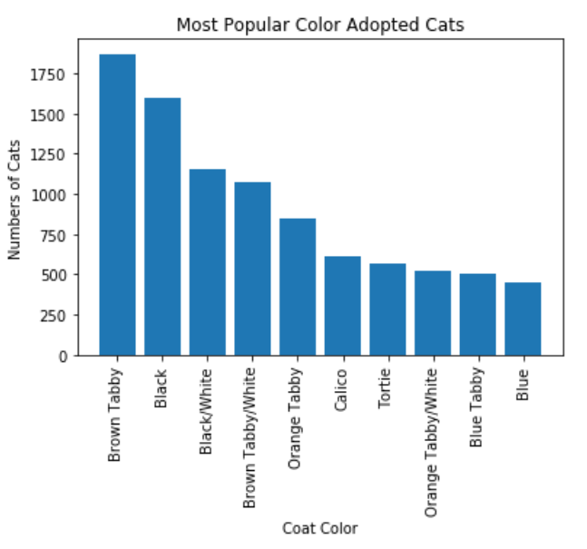
Data Source
Austin Animal Center Shelter

Slide 21
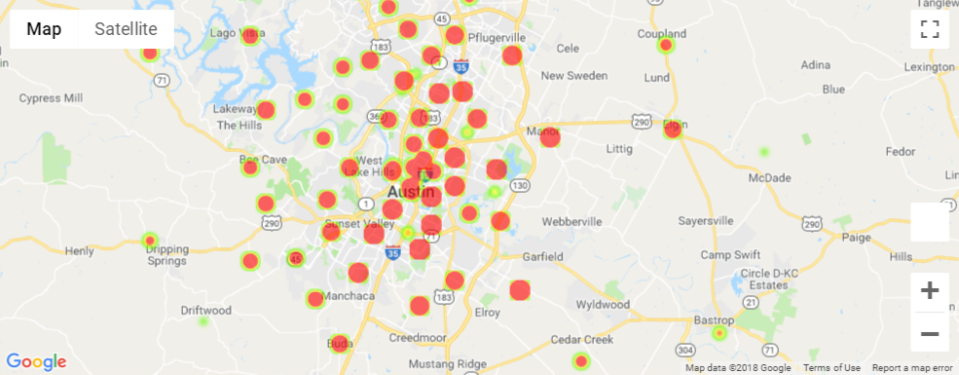
Heatmaps by intake locations - Dogs

Slide 22
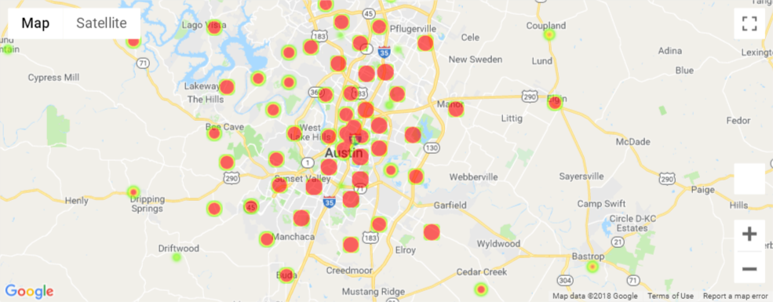
Heatmaps by intake locations - Cats

Slide 23
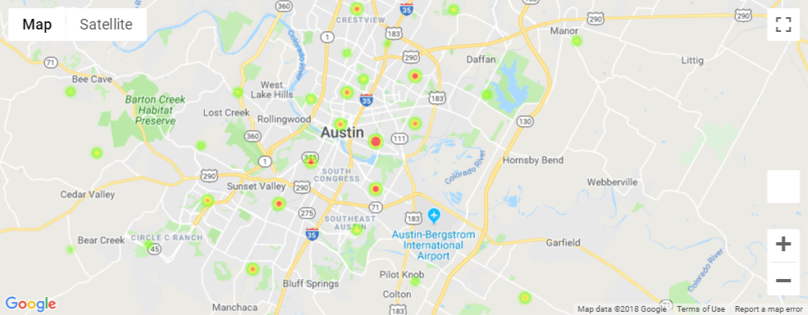
Heatmaps by intake locations - Birds

Slide 24
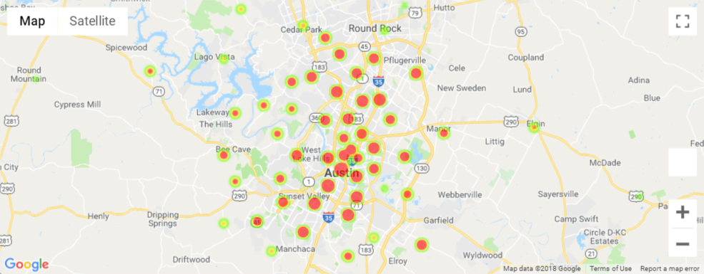
Heatmaps by intake locations - Others

Slide 25
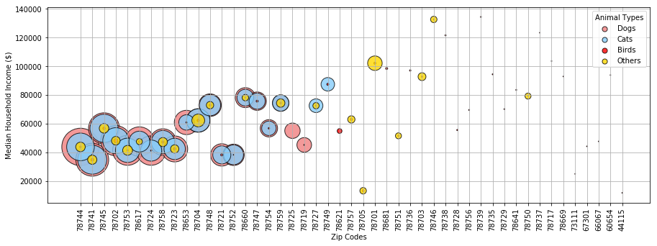
Do economics factors correlate with locations in intake data?

Slide 26
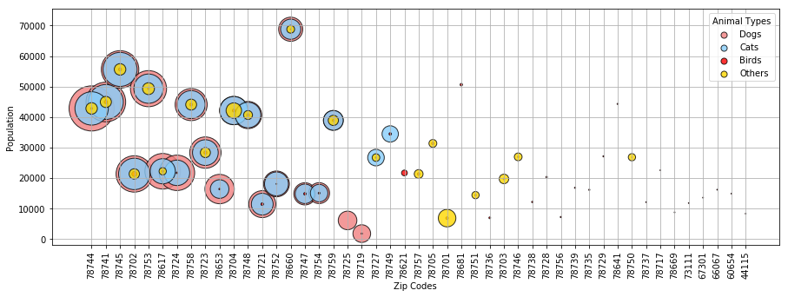
Are there population density factors impacting intakes?

Slide 27
Data Source
Austin Animal Center Shelter
Total Records: 79,672

Slide 28
Data Source
Austin Animal Center Shelter

Slide 29
Data Source
Austin Animal Center Shelter

Slide 30
Data Source
Austin Animal Center Shelter

Slide 31
Data Source
Austin Animal Center Shelter

Slide 32
Heatmaps by intake locations - Dogs

Slide 33
Heatmaps by intake locations - Cats

Slide 34
Heatmaps by intake locations - Birds

Slide 35
Heatmaps by intake locations - Others

Slide 36
Do economics factors correlate with locations in intake data?

Slide 37
Are there population density factors impacting intakes?

Slide 38
Austin Animal Center Shelter
Data Analysis - Project 1

Slide 39
Data Source
Austin Animal Center Shelter
https://www.kaggle.com/aaronschlegel/austin-animal-center-shelter-intakes-and-outcomes

Slide 40
Data Source
Austin Animal Center Shelter
What factors are most important in determining outcome type?
Do cats get adopted more frequently than dogs?
Do certain breeds get adopted more often than others? Does coat color affect adoption rates within breeds?
How does wildlife fare with respect to domestic animals? How about non-cat/dog animals? Compare wildlife to domestic animal types
How does intake condition impact outcome? Do sick animals fare worse when it comes to adoption?
How does age of animal affect outcome?
How does sex of animal affect outcome?
How does length of stay in shelter affect outcome?
In general, what animals live the longest?

Slide 41
Data Source
Austin Animal Center Shelter
What leads people to drop animals off?
Do economic factors (e.g. average income by zip code) correlate with locations in intake data? (requires blending)
Are there population density factors impacting intake rates? I.e. do animals get picked up more often in rural locations or dense urban locations? (requires blending)
Do extreme weather events correlate with spikes in intake? (requires blending)
Are there seasonal, monthly, or weekly patterns in intake volume?
Can we infer why random wildlife is showing up at animal shelters?
Are there trends in non-cat/dog animals showing up at shelters?
BASIC QUESTION:
What factors impact whether animals get spayed/neutered?
Do cats get spayed/neutered more frequently than dogs?
Do older animals get spayed/neutered less frequently than younger animals?
How do outcome types affect neutering/spaying rates?
Which type/breed of animal is more commonly brought in already spayed/neutered?

Slide 42
Clean up data and APIs
Address
Colony Creek And Hunters Trace in Austin (TX)
8700 Research Blvd in Austin (TX)
12034 Research Blvd in Austin (TX)
Austin (TX)
Ih 35 And 41St St in Austin (TX)
Gatlin Gun Rd And Brodie in Austin (TX)
Austin (TX)
Final Address
Street
Zip Code
Latitude
Longitude
API
Google API
Zip codes
Latitude
Longitude
Census.gov
Income
Population

Slide 43
Data Source
Austin Animal Center Shelter
Total Records: 79,672

Slide 44
Data Source
Austin Animal Center Shelter

Slide 45
Data Source
Austin Animal Center Shelter

Slide 46
Data Source
Austin Animal Center Shelter

Slide 47
Data Source
Austin Animal Center Shelter

Slide 48
Heatmaps by intake locations - Dogs

Slide 49
Heatmaps by intake locations - Cats

Slide 50
Heatmaps by intake locations - Birds

Slide 51
Heatmaps by intake locations - Others

Slide 52
Do economics factors correlate with locations in intake data?

Slide 53
Are there population density factors impacting intakes?

Slide 54
Data Source
Austin Animal Center Shelter
Total Records: 79,672

Slide 55
Data Source
Austin Animal Center Shelter

Slide 56
Data Source
Austin Animal Center Shelter

Slide 57
Data Source
Austin Animal Center Shelter

Slide 58
Data Source
Austin Animal Center Shelter

Slide 59
Heatmaps by intake locations - Dogs

Slide 60
Heatmaps by intake locations - Cats

Slide 61
Heatmaps by intake locations - Birds

Slide 62
Heatmaps by intake locations - Others

Slide 63
Do economics factors correlate with locations in intake data?

Slide 64
Are there population density factors impacting intakes?

